Slide 1
Building Web Application using ASP.NET Core MVC

Slide 2
Objectives
Overview ASP.NET Core
List the advantages of ASP.NET Core
Explain about WebServer
Overview ASP.NET MVC Architecture
Explain role of the Model, View and Controller
Explain about ViewBag, ViewData, TempData and Session
Explain about HTML Helper
Explain about Model Binding and Model Validation
Demo create ASP.NET Core MVC application with Entity Framework

Slide 3
ASP.NET Core Overview

Slide 4
Introduction to ASP.NET
ASP.NET is a web application framework designed and developed by Microsoft. ASP.NET is open source and a subset of the .NET Framework and successor of the classic ASP (Active Server Pages)
With version 1.0 of the .NET Framework, it was first released in January 2002. Before .NET and ASP.NET Web Form there was Classic ASP
ASP.NET is built on the CLR (Common Language Runtime) which allows the programmers to execute its code using any .NET language (C#, VB etc.)
It is specially designed to work with HTTP and for web developers to create dynamic web pages, web applications, web sites, and web services as it provides a good integration of HTML, CSS, and JavaScript

Slide 5
The Limitations of ASP.NET
ASP.NET Web Forms suffered from many issues, especially when building larger applications. In particular, a lack of testability, a complex stateful model, and limited influence over the generated HTML (making client-side development difficult) led developers to evaluate other options
Auto generated HTML does not provide full control to the developers
HTML ID management is compromised and it makes difficult to use client side languages like Jquery

Slide 6
What is the ASP.NET Core?
ASP.NET Core is the new version of the ASP.NET web framework mainly targeted to run on .NET Core platform
ASP.NET Core is a free, open-source, and cross-platform framework for building cloud-based applications, such as web apps, IoT apps, and mobile backends. It is designed to run on the cloud as well as on-premises
Same as .NET Core, it was architected modular with minimum overhead, and then other more advanced features can be added as NuGet packages as per application requirement. This results in high performance, require less memory, less deployment size, and easy to maintain
ASP.NET Core is an open source framework supported by Microsoft and the community, so we can also contribute or download the source code from the ASP.NET Core Repository on Github

Slide 7
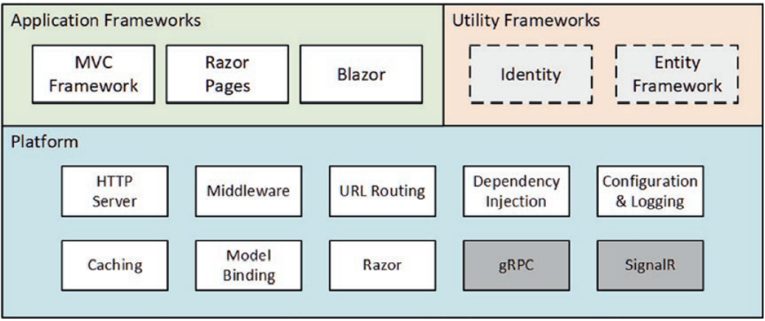
The Structure of ASP.NET Core
ASP.NET Core consists of a platform for processing HTTP requests, a series of principal frameworks for creating applications, and secondary utility frameworks that provide supporting features, as illustrated by the following figure:

Slide 8
Features of ASP.NET Core
Streamlined Web development
A system that is set to work on cloud
Good community base
An integrated platform for creating a variety of Web applications and APIs
Assimilation of latest frameworks
Support for a flexible and lightweight HTTP request channel
Support for hosting itself in a targeted process or on different platforms
Simultaneous versioning of applications
ASP.NET Core also allows us to create applications that follow the MVC architectural style, with a ready-made template that is available for use

Slide 9
Features of ASP.NET Core
Support build HTTP-based web services as well as RESTful services. A new addition to the capability in implementing microservices by the gRPC template
ASP.NET Core fully supports Razor, which contains an efficient language for creating our views and Tag Helpers, which allow logic to be written from the server side to generate HTML that can be used in Razor views
Blazor WebAssembly: Blazor apps that were rendered server-side. They can also be rendered client-side, enabling offline and standalone apps
Multi-Platform Web Apps: Blazor apps was originally conceived as a vehicle for web apps and works great in a browser. The goal is that this will work equally great for a mobile device, or a native desktop application

Slide 10
ASP.NET Core Advantages
Fast: ASP.NET Core no longer depends on System.Web.dll for browser-server communication. ASP.NET Core allows us to include packages that we need for our application. This reduces the request pipeline and improves performance and scalability
IoC Container: It includes the built-in IoC container for automatic dependency injection which makes it maintainable and testable
Integration with Modern UI Frameworks: It allows us to use and manage modern UI frameworks such as AngularJS, ReactJS, Umber, Bootstrap, etc. using Bower (a package manager for the web)

Slide 11
ASP.NET Core Advantages
Hosting: ASP.NET Core web application can be hosted on multiple platforms with any web server such as IIS, Apache etc. It is not dependent only on IIS as a standard .NET Framework
Code Sharing: It allows you to build a class library that can be used with other .NET frameworks such as .NET Framework 4.x or Mono (a single code base can be shared across frameworks)
Side-by-Side App Versioning: ASP.NET Core runs on .NET Core, which supports the simultaneous running of multiple versions of applications
Smaller Deployment Footprint: ASP.NET Core application runs on .NET Core, which is smaller than the full .NET Framework. So, the application which uses only a part of .NET CoreFX will have a smaller deployment size. This reduces the deployment footprint

Slide 12
WebServer in ASP.NET Core
Prior versions of ASP.NET applications could only be deployed to Windows servers using Internet Information Services (IIS). ASP.Net Core can be deployed to multiple operating systems in multiple ways, including outside of a web server
The highlevel options are as follows:
On a Windows server (including Azure) using IIS
On a Windows server (including Azure app services) outside of IIS
On a Linux server using Apache or NGINX
On Windows or Linux in a Docker container

Slide 13
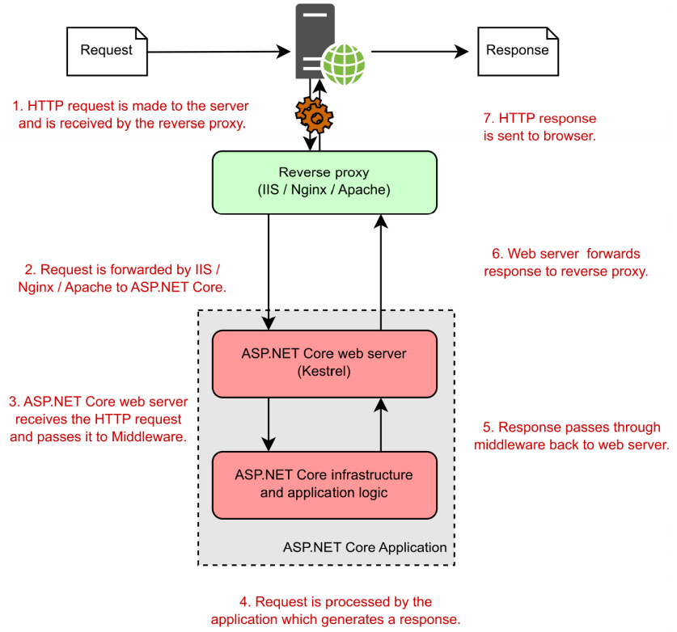
The hosting model for ASP.NET Core. Requests are received by the reverse proxy and are forwarded to the Kestrel web server. The same application can run behind various reverse proxies without modification

Slide 14
Routing in ASP.NET Core
The Routing is the process by which ASP.NET Core inspects the incoming URLs and maps them to Controller Actions. It also used to generate the outgoing URLs
This process is handled by the Routing Middleware. The Routing Middleware is available in Microsoft.AspNetCore.Routing Namespace
The Routing has two main responsibilities:
It maps the incoming requests to the Controller Action
Generate an outgoing URLs that correspond to Controller actions

Slide 15
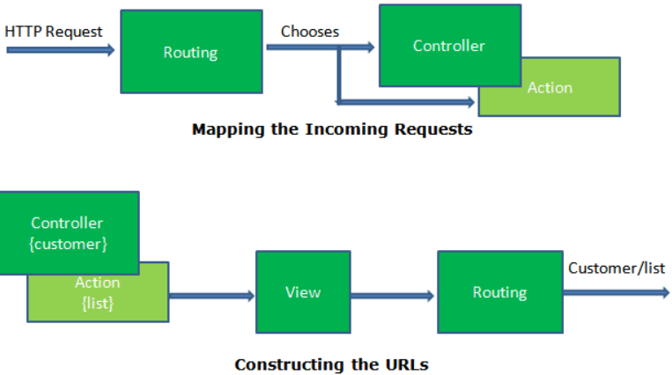
Routing in ASP.NET Core

Slide 16
Route and Route Handler
The Route is similar to a roadmap. We use a roadmap to go to our destination. Similarly, the ASP.NET Core Apps uses the Route to go to the controller action
The Each Route contains a Name, URL Pattern (Template), Defaults and Constraints. The URL Pattern is compared to the incoming URLs for a match. An example of URL Pattern is {controller=Home}/{action=Index}/{id?}
The Route is defined in the Microsoft.AspNetCore.Routing namespace
The Route Handler is the Component that decides what to do with the route. When the routing Engine locates the Route for an incoming request, it invokes the associated RouteHandler and passes the Route for further processing
The Route handler is the class which implements the IRouteHandler interface

Slide 17
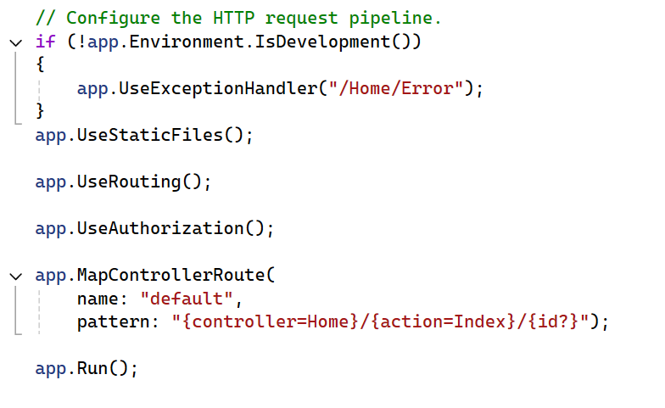
How to Set up Routes
There are two different ways by which we can set up routes:
Convention-based routing: in Program.cs class
Attribute routing
Name of Route
URL Pattern

Slide 18
Working with ASP.NET Core MVC

Slide 19
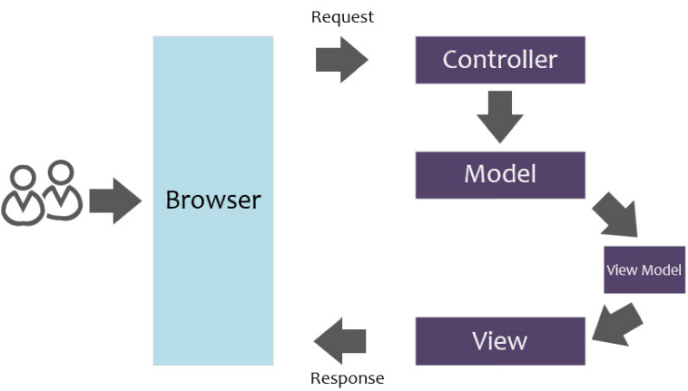
Introducing the MVC Pattern
The Model-View-Controller (MVC) pattern has been around since the 1970s, originally created as a pattern for use in Smalltalk
The pattern has made a resurgence recently, with implementations in many different and varied languages, including Java (Spring Framework), Ruby (Ruby on Rails), and .NET (ASP.NET MVC)
The MVC request and response flow

Slide 20
Introducing the MVC Pattern
Controllers are responsible for handling any user interactions and requests, processing any logic that is required to fulfill the request, and ultimately, returning a response to the user. In other words, controllers orchestrate the flow of logic
Models are components that actually implement domain-specific logic. Often, models contain entity objects, our business logic, and data access code that retrieves and stores data. We should consider separating our business logic and data access layer to value the separation of concerns and single responsibility

Slide 21
Introducing the MVC Pattern
Views are components that make up our UI or page. Typically, views are just Razor files (.cshtml) that contain HTML, CSS, JavaScript, and C#-embedded code
ViewModel is simply a class that houses some properties that are only needed for the view. ViewModel is optional because we can technically return a model to a view directly. It enables us to expose only the data that need instead of returning all data from entity object via models

Slide 22
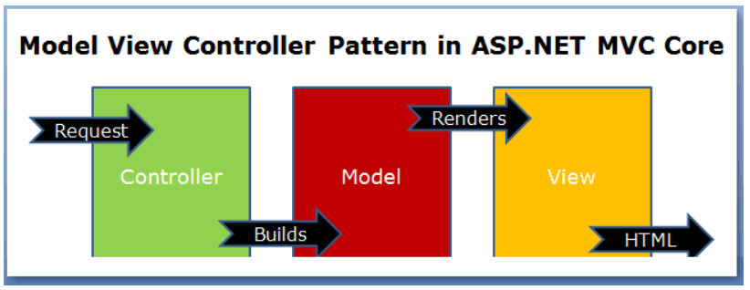
How MVC Pattern works in ASP.NET Core

Slide 23
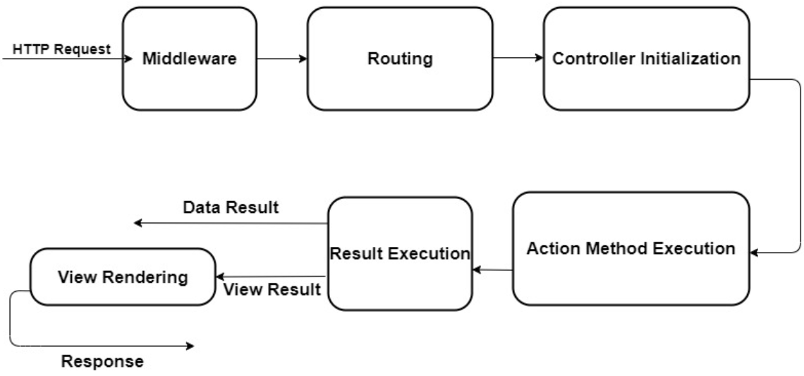
ASP.NET Core MVC Request Life Cycle

Slide 24
Demo 01: Create ASP.NET Core MVC Project using Visual Studio.NET

Slide 25
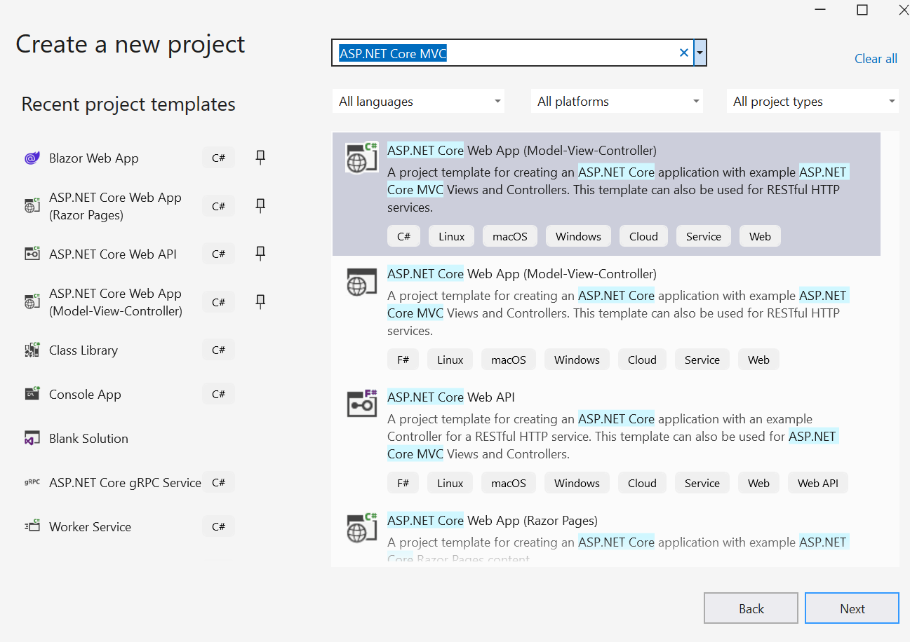
1. Open Visual Studio.NET , File | New | Project
1
2
3

Slide 26
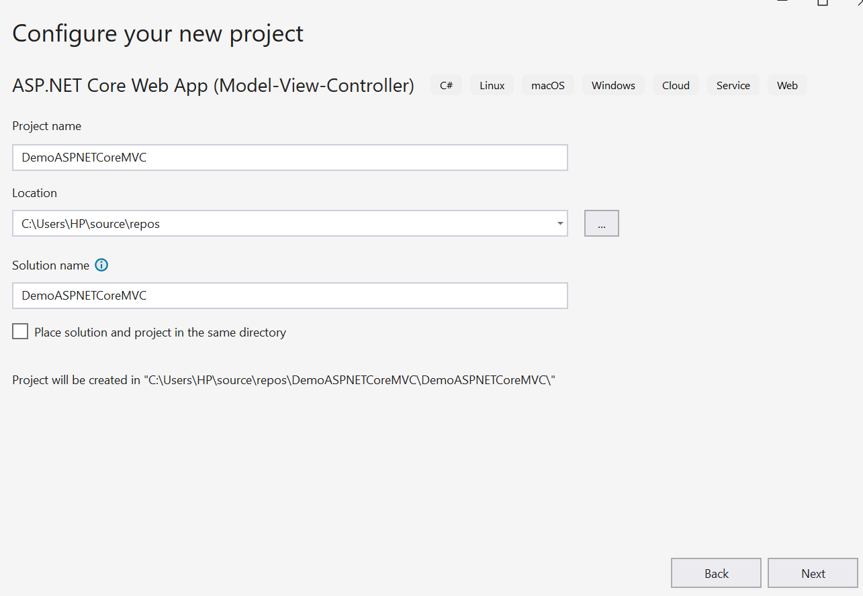
2. Fill out Project name: MyWebApp and Location then click Next
4
5
6

Slide 27
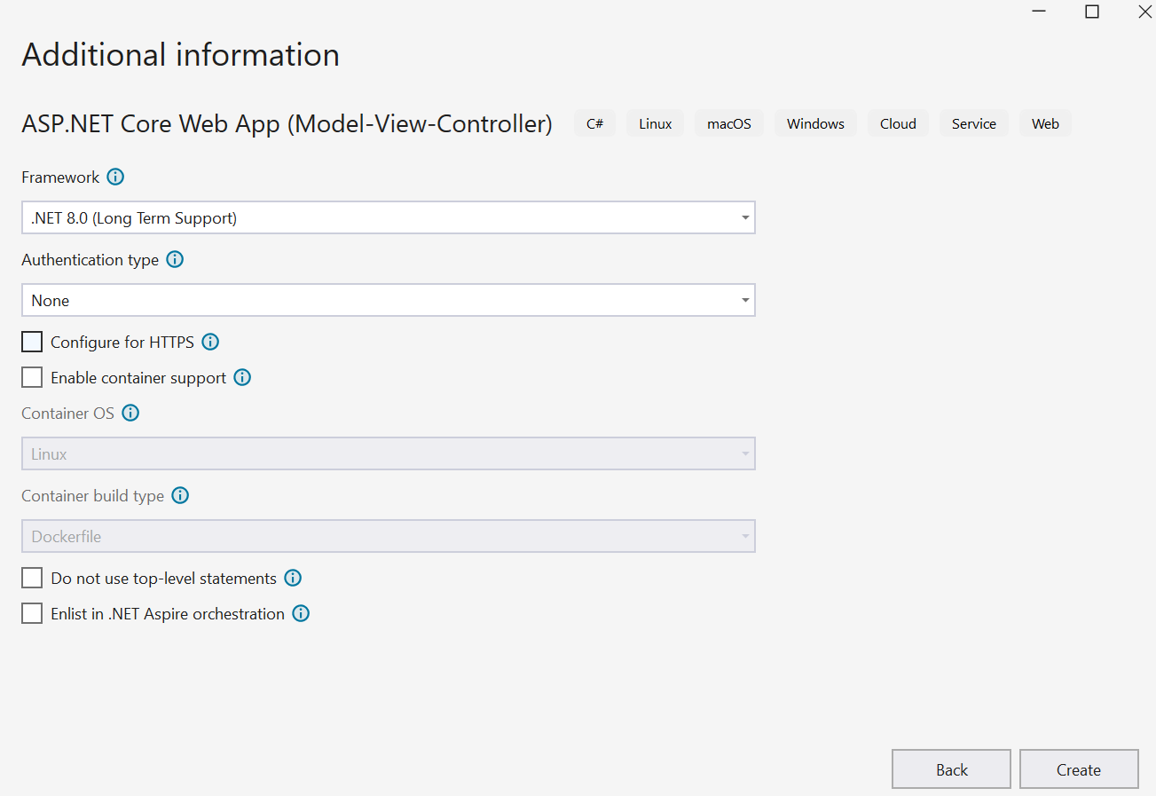
3. Config as follows then click Create
7
8
9

Slide 28
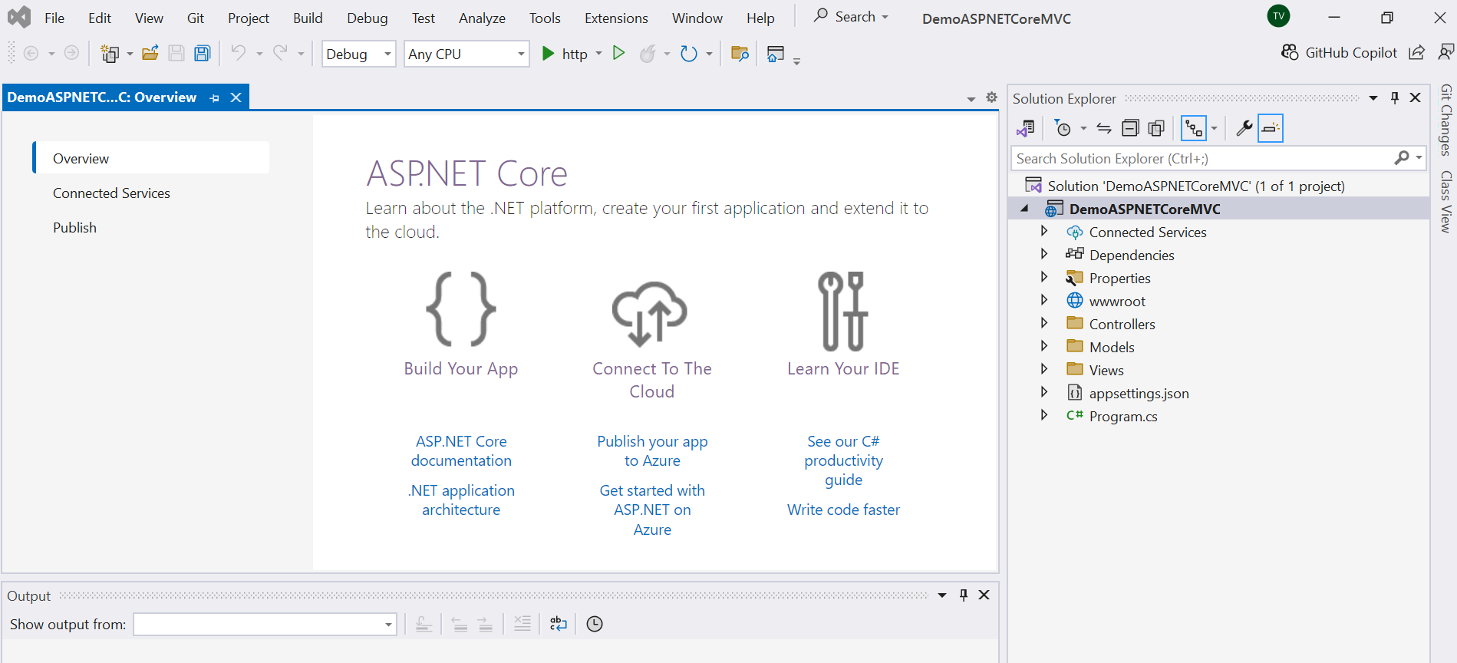
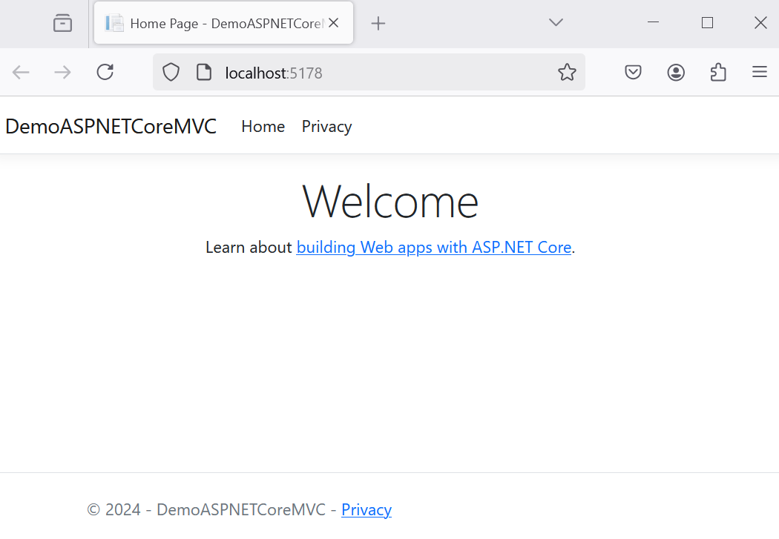
4. Press Ctrl+F5 to run project

Slide 29
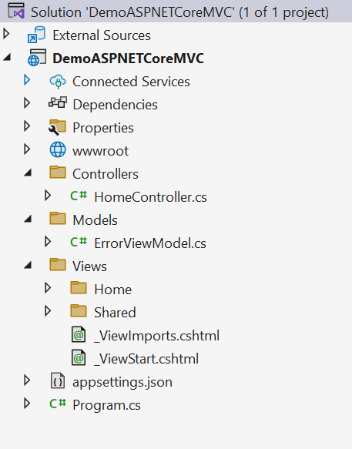
Default MVC Project Structure

Slide 30
Default MVC Project Structure
Connected Services: This allows us to connect to services such as Application Insights, Azure Storage, mobile, and other ASP.NET Core services that our application depends on, without we have to manually configure their connection and configurations
Dependencies: This is where project dependencies are located, such as NuGet packages, external assemblies, the SDK, and framework dependencies needed for the application
Properties: This folder contains the launchSettings.json file, where you can define application variables and profiles for running the app
wwwroot: This folder contains all your static files, which will be served directly to the clients, including HTML, CSS, images, and JavaScript files

Slide 31
Default MVC Project Structure
appsettings.json: This is where we configure application-specific settings. Keep in mind though that sensitive data should not be added to this file. We should consider storing secrets and sensitive information in a vault or secrets manager
Program.cs: This file is the main entry point for the application. This is where we build the host for application. By default, the ASP.NET Core app builds a generic host that encapsulates all framework services needed to run the application

Slide 32
Default MVC Project Structure
The Controllers folder is where the ASP.NET Core MVC and API implementations (and the routing engine) expect that the controllers for application are placed
The Views folder is where the views for the application are stored. Each controller gets its own folder under the main Views folder named after the controller name (minus the Controller suffix). The action methods will render views in their controller’s folder by default
For example, the Views/Home folder holds all the views for the HomeController controller class
The Shared Folder: This folder is accessible to all controllers and their action methods. After searching the folder named for the controller, if the view can’t be found, then the Shared folder is searched for the view

Slide 33
Controller Class
Controller class inherited from the ControllerBase class
Some of the Helper Methods Provided by the Controller Class:
Helper Method | Description
ViewData/TempData/ViewBag | Provide data to the view through the ViewDataDictionary, TempDataDictionary, and dynamic ViewBag transport
View | Returns a ViewResult (derived from ActionResult) as the HTTP response. Defaults to view of the same name as the action method, with the option of specifying a specific view. All options allow specifying a ViewModel that is strongly typed and sent to the View
PartialView | Returns a PartialViewResult to the response pipeline
ViewComponent | Returns a ViewComponentResult to the response pipeline
Json | Returns a JsonResult containing an object serialized as JSON as the response
OnActionExecuting | Executes before an action method executes
OnActionExecuted | Executes after an action method executes

Slide 34
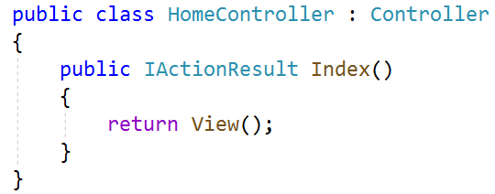
Understanding Controllers
The Controller in MVC architecture handles any incoming URL request and the name of the controller class must be suffixed with the name Controller
Controllers in ASP.NET MVC inherited from the Controller class
Controller class contains public methods called Action methods. Controller and its action method handles incoming browser requests, retrieves necessary model data and returns appropriate responses

Slide 35
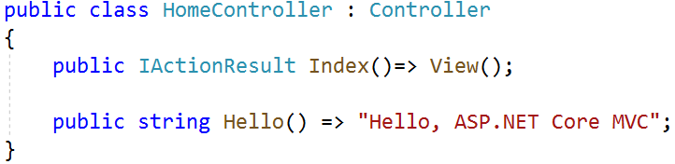
Understanding Action Method
All the public methods of the Controller class are called Action methods. They are like any other normal methods with the following restrictions:
Action method must be public. It cannot be private or protected
Action method cannot be a static method

Slide 36
Understanding Action Method
Miscellaneous Action Results
Action Method | Description
IActionResult | Defines a contract that represents the result of an action method.
ActionResult | A default implementation of IActionResult
ContentResult | Represents a text result
EmptyResult | Represents an ActionResult that when executed will do nothing
JsonResult | An action result which formats the given object as JSON
PartialViewResult | Represents an ActionResult that renders a partial view to the response
ViewResult | Represents an ActionResult that renders a view to the response
ViewComponentResult | An IActionResult which renders a view component to the response

Slide 37
Understanding Model
The Model in an MVC application represents the state of the application and any business logic or operations that should be performed by it
Business logic should be encapsulated in the model, along with any implementation logic for persisting the state of the application
Strongly-typed views typically use ViewModel types designed to contain the data to display on that view. The controller creates and populates these ViewModel instances from the model
The Model is divided several categories based on how and where they are used. The Three main distinctions are: Domain Model, View Model and Edit Model

Slide 38
Understanding View
The View is responsible for rendering the model to the Users
The Controller gets the request and executes the appropriate business logic and gets the required data (model) then delegates the responsibility of rendering the model to the View
Responsibilities of the Views
The rendering the data or model is the only responsibility of the View. The Views should not contain any logic and must not do any processing
The View can use any format to return to the user. The format could be HTML, JSON, XML or any other format for the user to consume as the response to the web request

Slide 39
Demo 02: Create Model-View-Controller (Reuse Demo-01)

Slide 40
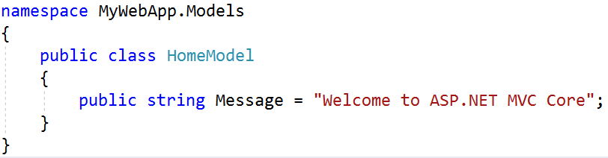
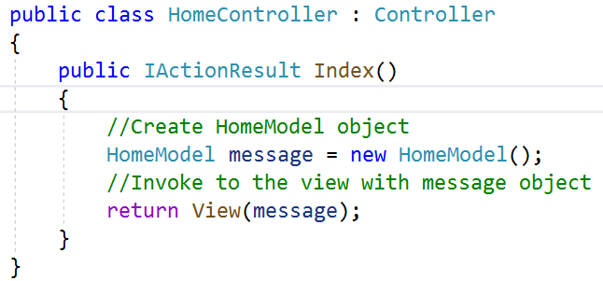
1.Right-click on Model folder | Add | Class, named HomeModel.cs then write codes as follows:
2.Open HomeController.cs then update code as follows:

Slide 41
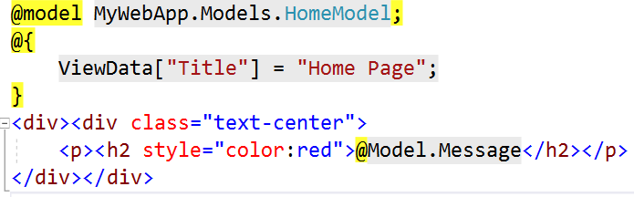
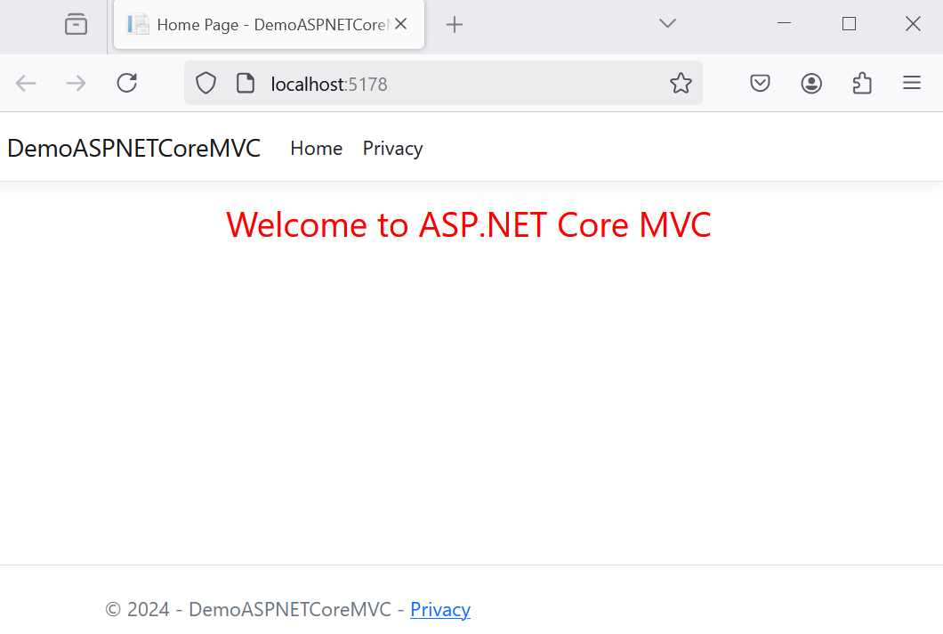
3.Open Index.cshtml from View | Home folder then update as follows:
4.Right-click on Index.cshtml view , select View in Browser (or press Ctrl+F5 to run project)

Slide 42
The Razor Syntax
The Razor uses the @ symbol to transition from HTML markup to the C# code.The following are the two ways, by which you can achieve the transitions
Using Razor code expressions : started with @ and followed by C# code. The Code expression can be either Implicit or Explicit
Using Razor code blocks: started with @ symbol followed by curly braces and can use code blocks anywhere in the markup. A Razor code block can be used manipulate a model, declare variables, and set local properties on a view, etc
These expressions are evaluated by the Razor View Engine and written to the response

Slide 43
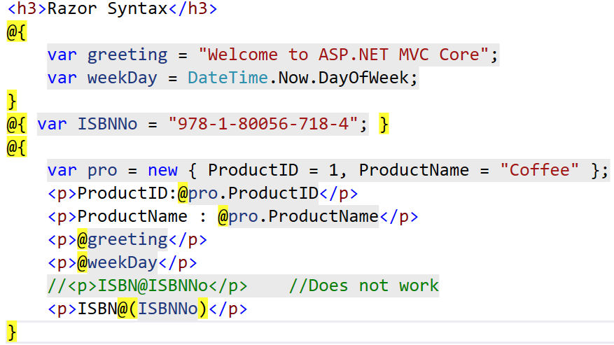
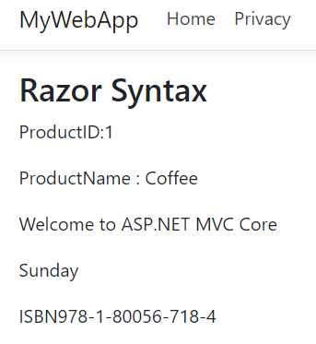
The Razor Syntax
Razor Code blocks
Implicit Razor Expressions
Explicit Razor Expressions

Slide 44
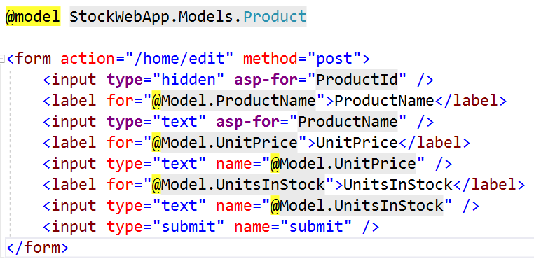
Strongly Typed View
The view which binds to a specific type of ViewModel is called as Strongly Typed View. By specifying the model, the Visual Studio provides the intellisense and compile time checking of type
In the strongly typed View, we let the View know the type of ViewModel being passed to it, using the @model directive

Slide 45
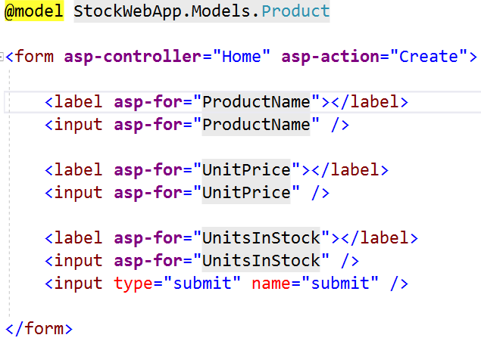
Tag Helper
The Tag helpers help us to write HTML elements in razor markup using easy to use syntax
They look just like standard HTML code but it is processed by Razor engine on the server giving it all the advantageous of server-side rendering
More Tag Helper:
https://docs.microsoft.com/en-us/aspnet/core/mvc/views/tag-helpers/intro?view=aspnetcore-5.0

Slide 46
Model Binding
The Model binding is the process of mapping the data posted over an HTTP request to the parameters of the action method in the Controller
The HTTP Request can contain data in various formats. The data can contain in the HTML form fields. It could be part of the route values. It could be part of the query string or it may contain in the body of the request
ASP.NET Core model binding mechanism allows us easily bind those values to the parameters in the action method. These parameters can be of the primitive type or complex type

Slide 47
public class ProductEditModel
{
public int ID{ get; set; }
public string Name { get; set; }
public decimal Rate { get; set; }
public int Rating { get; set; }
}
<form action="/home/Create" method="post">
<label for="Name">Name</label>
<input type="text" name="Name" />
<label for="Rate">Rate</label>
<input type="text" name="Rate" />
<label for="Rating">Rating</label>
<input type="text" name="Rating" />
<input type="submit" name="submit" />
</form>
[HttpPost]
public IActionResult Create(ProductEditModel model){
string message = "";
if (ModelState.IsValid) {
message = "product " + model.Name + " created successfully" ;
}
else{
message = "Failed to create the product. Please try again";
}
return Content(message);
}

Slide 48
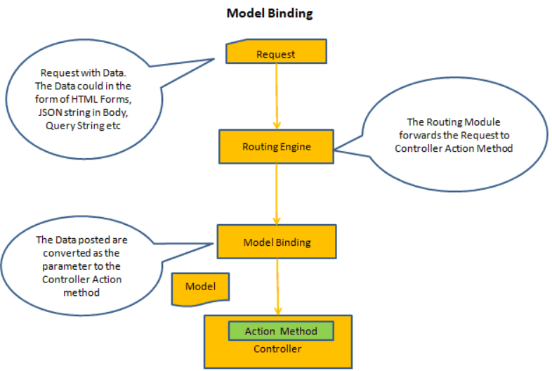
How Model Binding works

Slide 49
Model Validation
Model state represents errors that come from two subsystems: model binding and model validation
Errors that originate from model binding are generally data conversion errors. For example, an "x" is entered in an integer field. Model validation occurs after model binding and reports errors where data doesn't conform to business rules
Both model binding and model validation occur before the execution of a controller action or a Razor Pages handler method
[Required(AllowEmptyStrings =false,ErrorMessage ="Please enter the name")]
[StringLength(maximumLength:25,MinimumLength =10,ErrorMessage ="Length must be between 10 to 25")]
public string Name { get; set; }

Slide 50
Model Validation
[CreditCard]: Validates that the property has a credit card format. Requires jQuery Validation Additional Methods
[Compare]: Validates that two properties in a model match
[EmailAddress]: Validates that the property has an email format
[Phone]: Validates that the property has a telephone number format
[Range]: Validates that the property value falls within a specified range
[RegularExpression]: Validates that the property value matches a specified regular expression
[Required]: Validates that the field is not null. See [Required] attribute for details about this attribute's behavior
[StringLength]: Validates that a string property value doesn't exceed a specified length limit
[Url]: Validates that the property has a URL format
[Remote]: Validates input on the client by calling an action method on the server

Slide 51
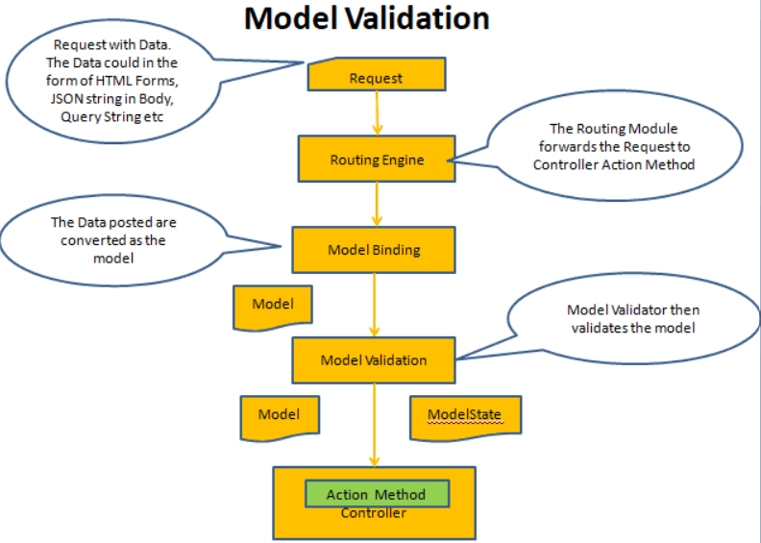
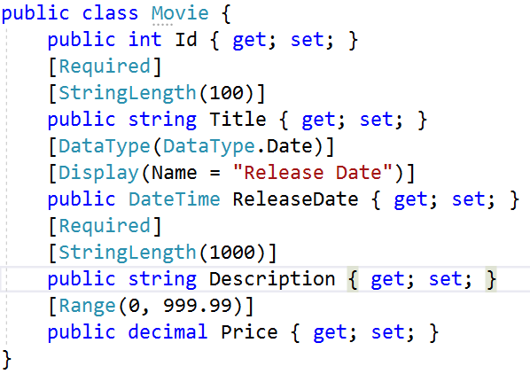
How Model Validation works

Slide 52
Session and State Management
HTTP is a stateless protocol. By default, HTTP requests are independent messages that don't retain user values. We can use several approaches to preserve user data between requests as follows:
Storage approach | Storage mechanism
Cookies | HTTP cookies. May include data stored using server-side app code
Session state | HTTP cookies and server-side app code
TempData | HTTP cookies or session state
Query strings | HTTP query strings
Hidden fields | HTTP form fields
HttpContext.Items | Server-side app code
Cache | Server-side app code

Slide 53
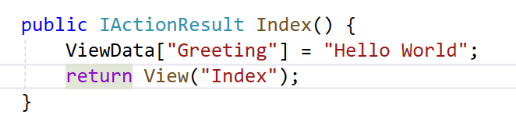
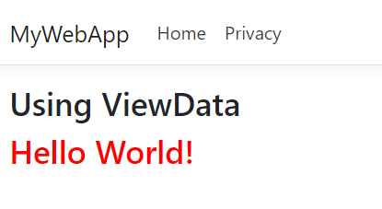
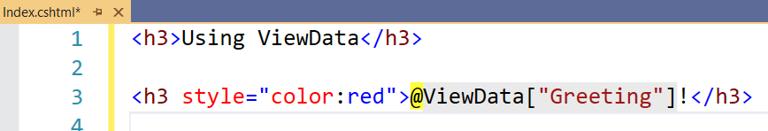
ViewData
View Data is one of the most common and popular technique with the help of which we can pass the data from the controller to view
Normally, view data is actually representing a dictionary which contains a key/value pair
The below code demonstrates the Index method which will return the view along with data

Slide 54
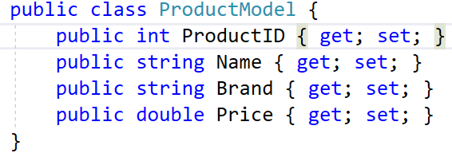
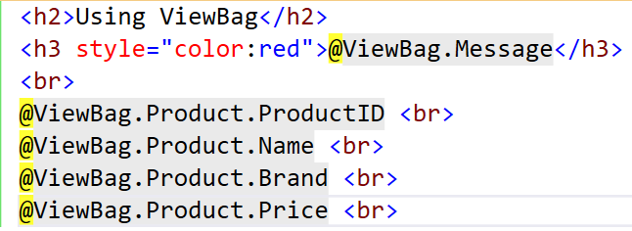
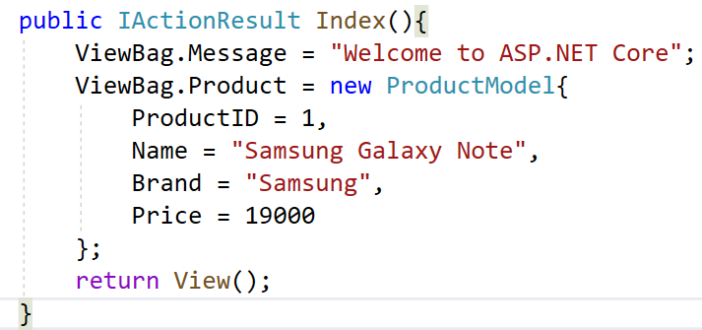
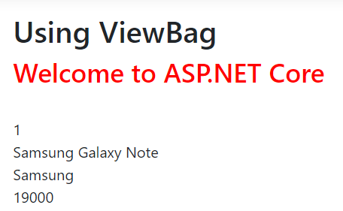
ViewBag
View Bag is quite similar to the ViewData. The main concept of the view bag is an instance of dynamic property
View: Index
ProductModel
ProductController

Slide 55
TempData
Temp data is one of another data passing techniques from the controller method to view
Temp data always return a data dictionary so that it can be derived from TempDataDictionary class
It is worked as a temporary data storage. It will keep the data at the time of the HTTP request. Temp data is most useful to transfer data between different action methods in the different controllers. In the internal mechanism, temp data is basically used session variables
It is mainly used to store data as a one-time message. We can keep the Tempdata source after the view is rendered by using the TempData.Keep() method

Slide 56
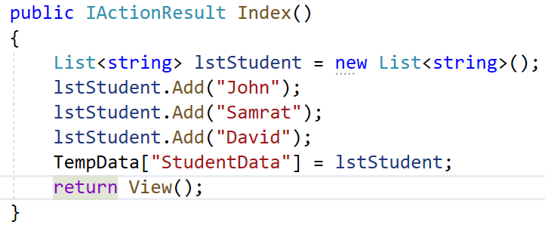
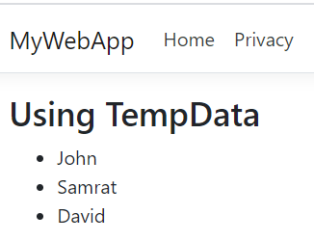
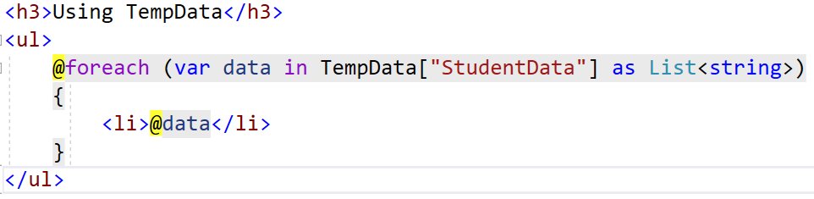
TempData

Slide 57
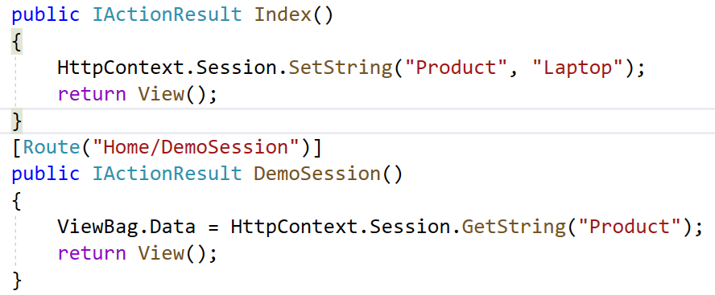
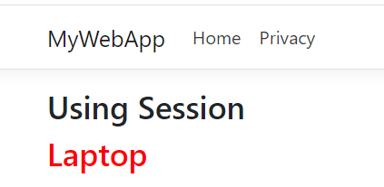
Session
Session state is an ASP.NET Core scenario for storage of user data while the user browses a web app
Session state uses a store maintained by the app to persist data across requests from a client. The session data is backed by a cache and considered ephemeral data

Slide 58
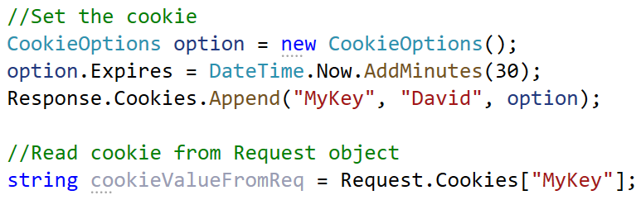
Cookies
Cookies store data across requests. Because cookies are sent with every request, their size should be kept to a minimum
Ideally, only an identifier should be stored in a cookie with the data stored by the app. Most browsers restrict cookie size to 4096 bytes
Cookies are key-value pair collections where we can read, write and delete using key

Slide 59
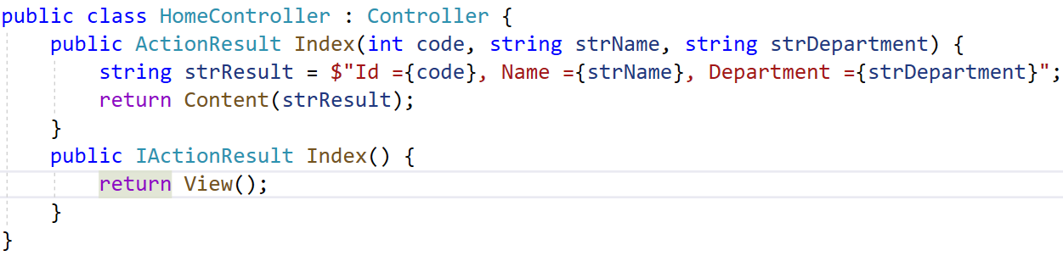
QueryString
This technique normally used to pass some from the view engine to the controller using the access URL. But it can accept only some limited amount of data which can be passed from one request to another request

Slide 60
HttpContext.Items and Cache
The HttpContext.Items collection is used to store data while processing a single request
The collection's contents are discarded after a request is processed. The Items collection is often used to allow components or middleware to communicate when they operate at different points in time during a request and have no direct way to pass parameters
Caching is an efficient way to store and retrieve data. The app can control the lifetime of cached items
Cached data isn't associated with a specific request, user, or session. Do not cache user-specific data that may be retrieved by other user requests

Slide 61
Demo 03: Working with Entity Framework

Slide 62
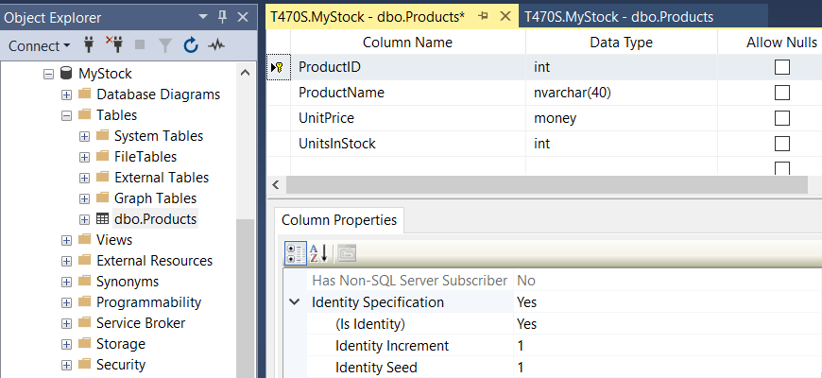
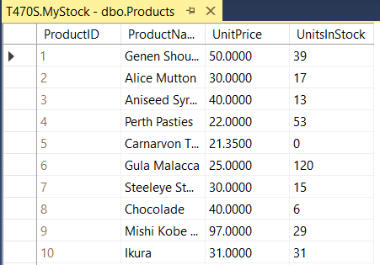
Create a sample database named MyStock for demonstrations

Slide 63

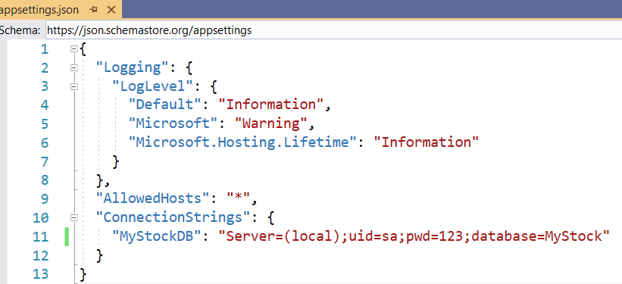
1.Create a ASP.NET Core MVC application named MyStockApp
2. Install the following packages from Nuget:
3.Open appsettings.json , click Add and add connection string as follows:

Slide 64
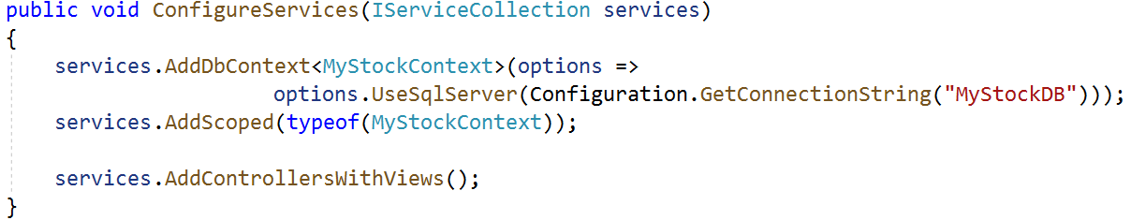
4.Right-click on the project, select Open in Terminal. On Developer PowerShell dialog, execute the following commands to generate model (Copy and Paste the below command):
dotnet ef dbcontext scaffold Name=ConnectionStrings:MyStockDB Microsoft.EntityFrameworkCore.SqlServer --output-dir Models
5.Open Startup.cs and write codes for ConfigureService method as follows:
//add two namespaces
using StockWebApp.Models;
using Microsoft.EntityFrameworkCore;
//…

Slide 65
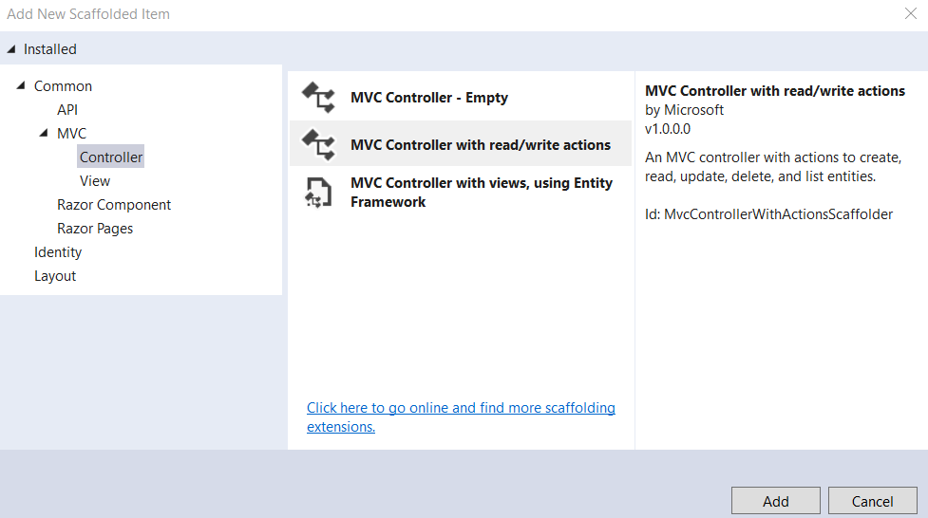
6.Right-click on Controller folder | Add | Controller then setup as follows:
1
2

Slide 66
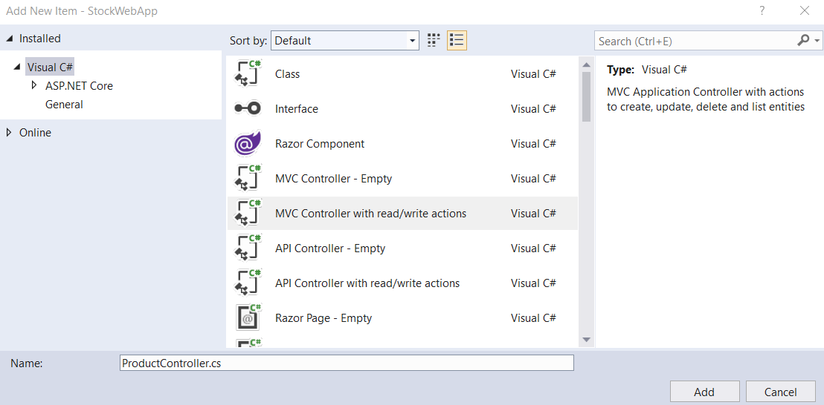
3
5
4

Slide 67
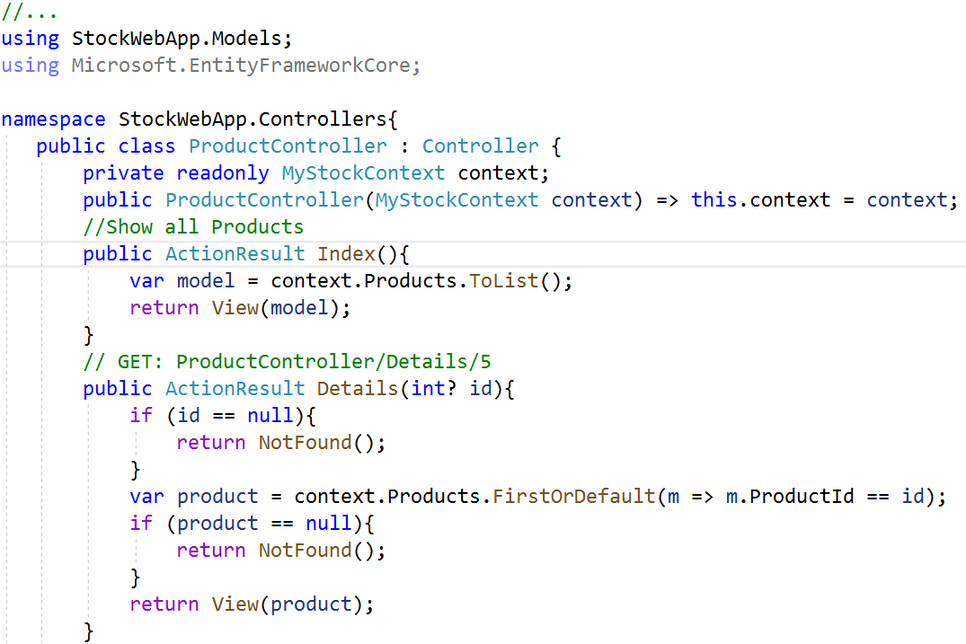
7.Write codes for action methods of ProductController.cs as follows:

Slide 68
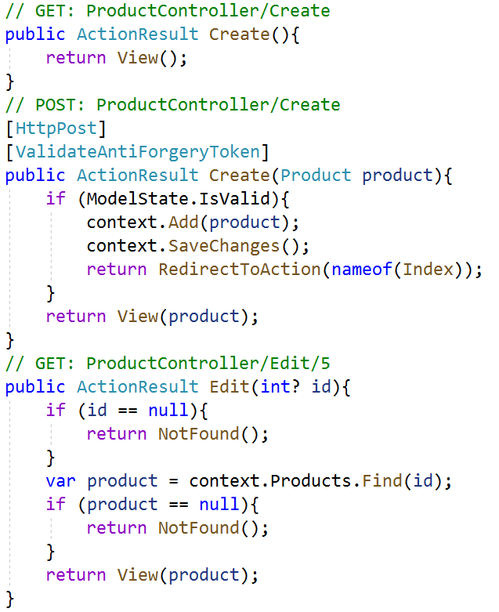
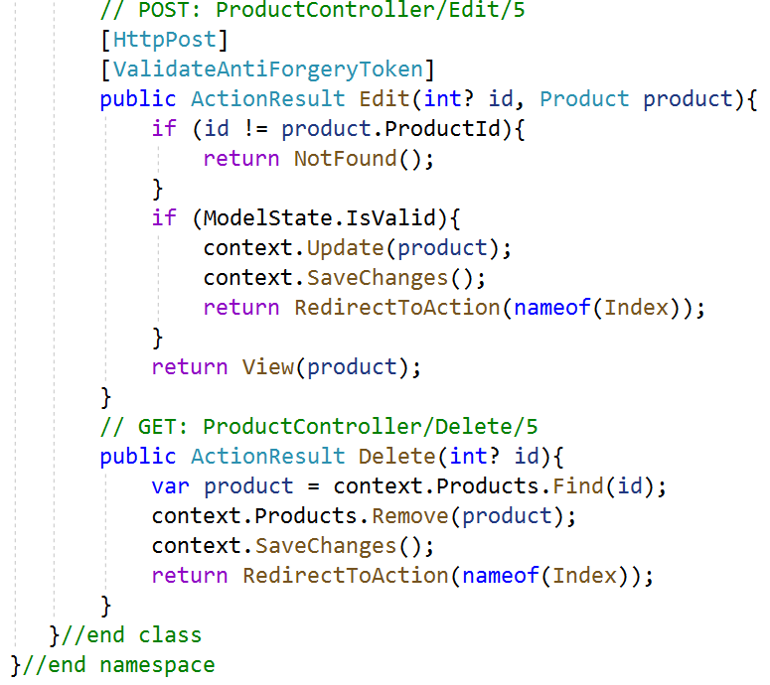

Slide 69
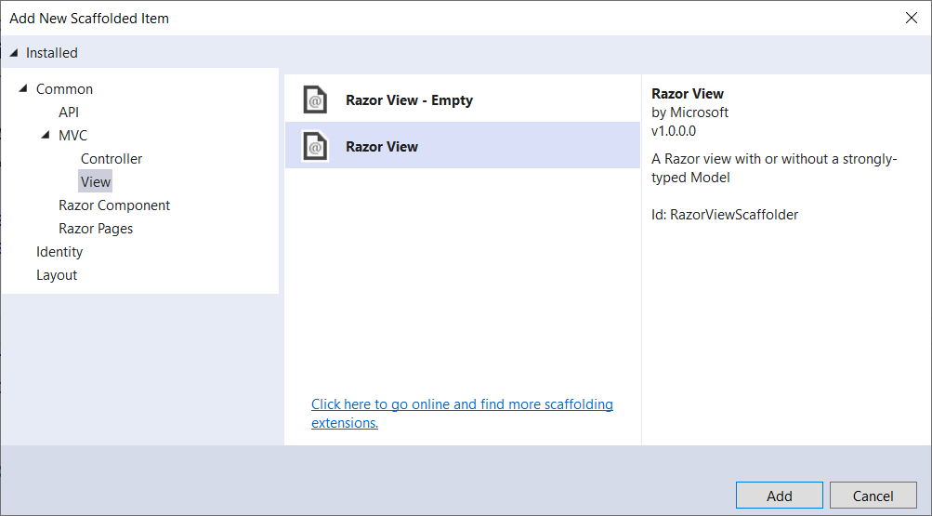
8.Right-click on View folder | Add | New Folder named Product
9.Right-click on Product folder | Add | View named Index as follows:
1
2

Slide 70


Index view (show product list)
3
4
5
6
7
8
Repeat this step to add views: Details, Create and Edit as the next figures

Slide 71


Details view

Slide 72


Create view

Slide 73


Edit view

Slide 74


10.Open index.cshtml view of Product folder and update contents as follows:
11.Open _Layout.cshtml view in the View | Shared folder, add tags to navigate to Index view of Product controller as follows then run project:

Slide 75


Slide 76
Summary
Concepts were introduced:
Overview ASP.NET Core
List the advantages of ASP.NET Core
Explain about WebServer
Overview ASP.NET MVC Architecture
Explain role of the Model, View and Controller
Explain about ViewBag, ViewData, TempData and Session
Explain about HTML Helper
Explain about Model Binding and Model Validation
Demo create ASP.NET Core MVC application with Entity Framework

